Slide 1



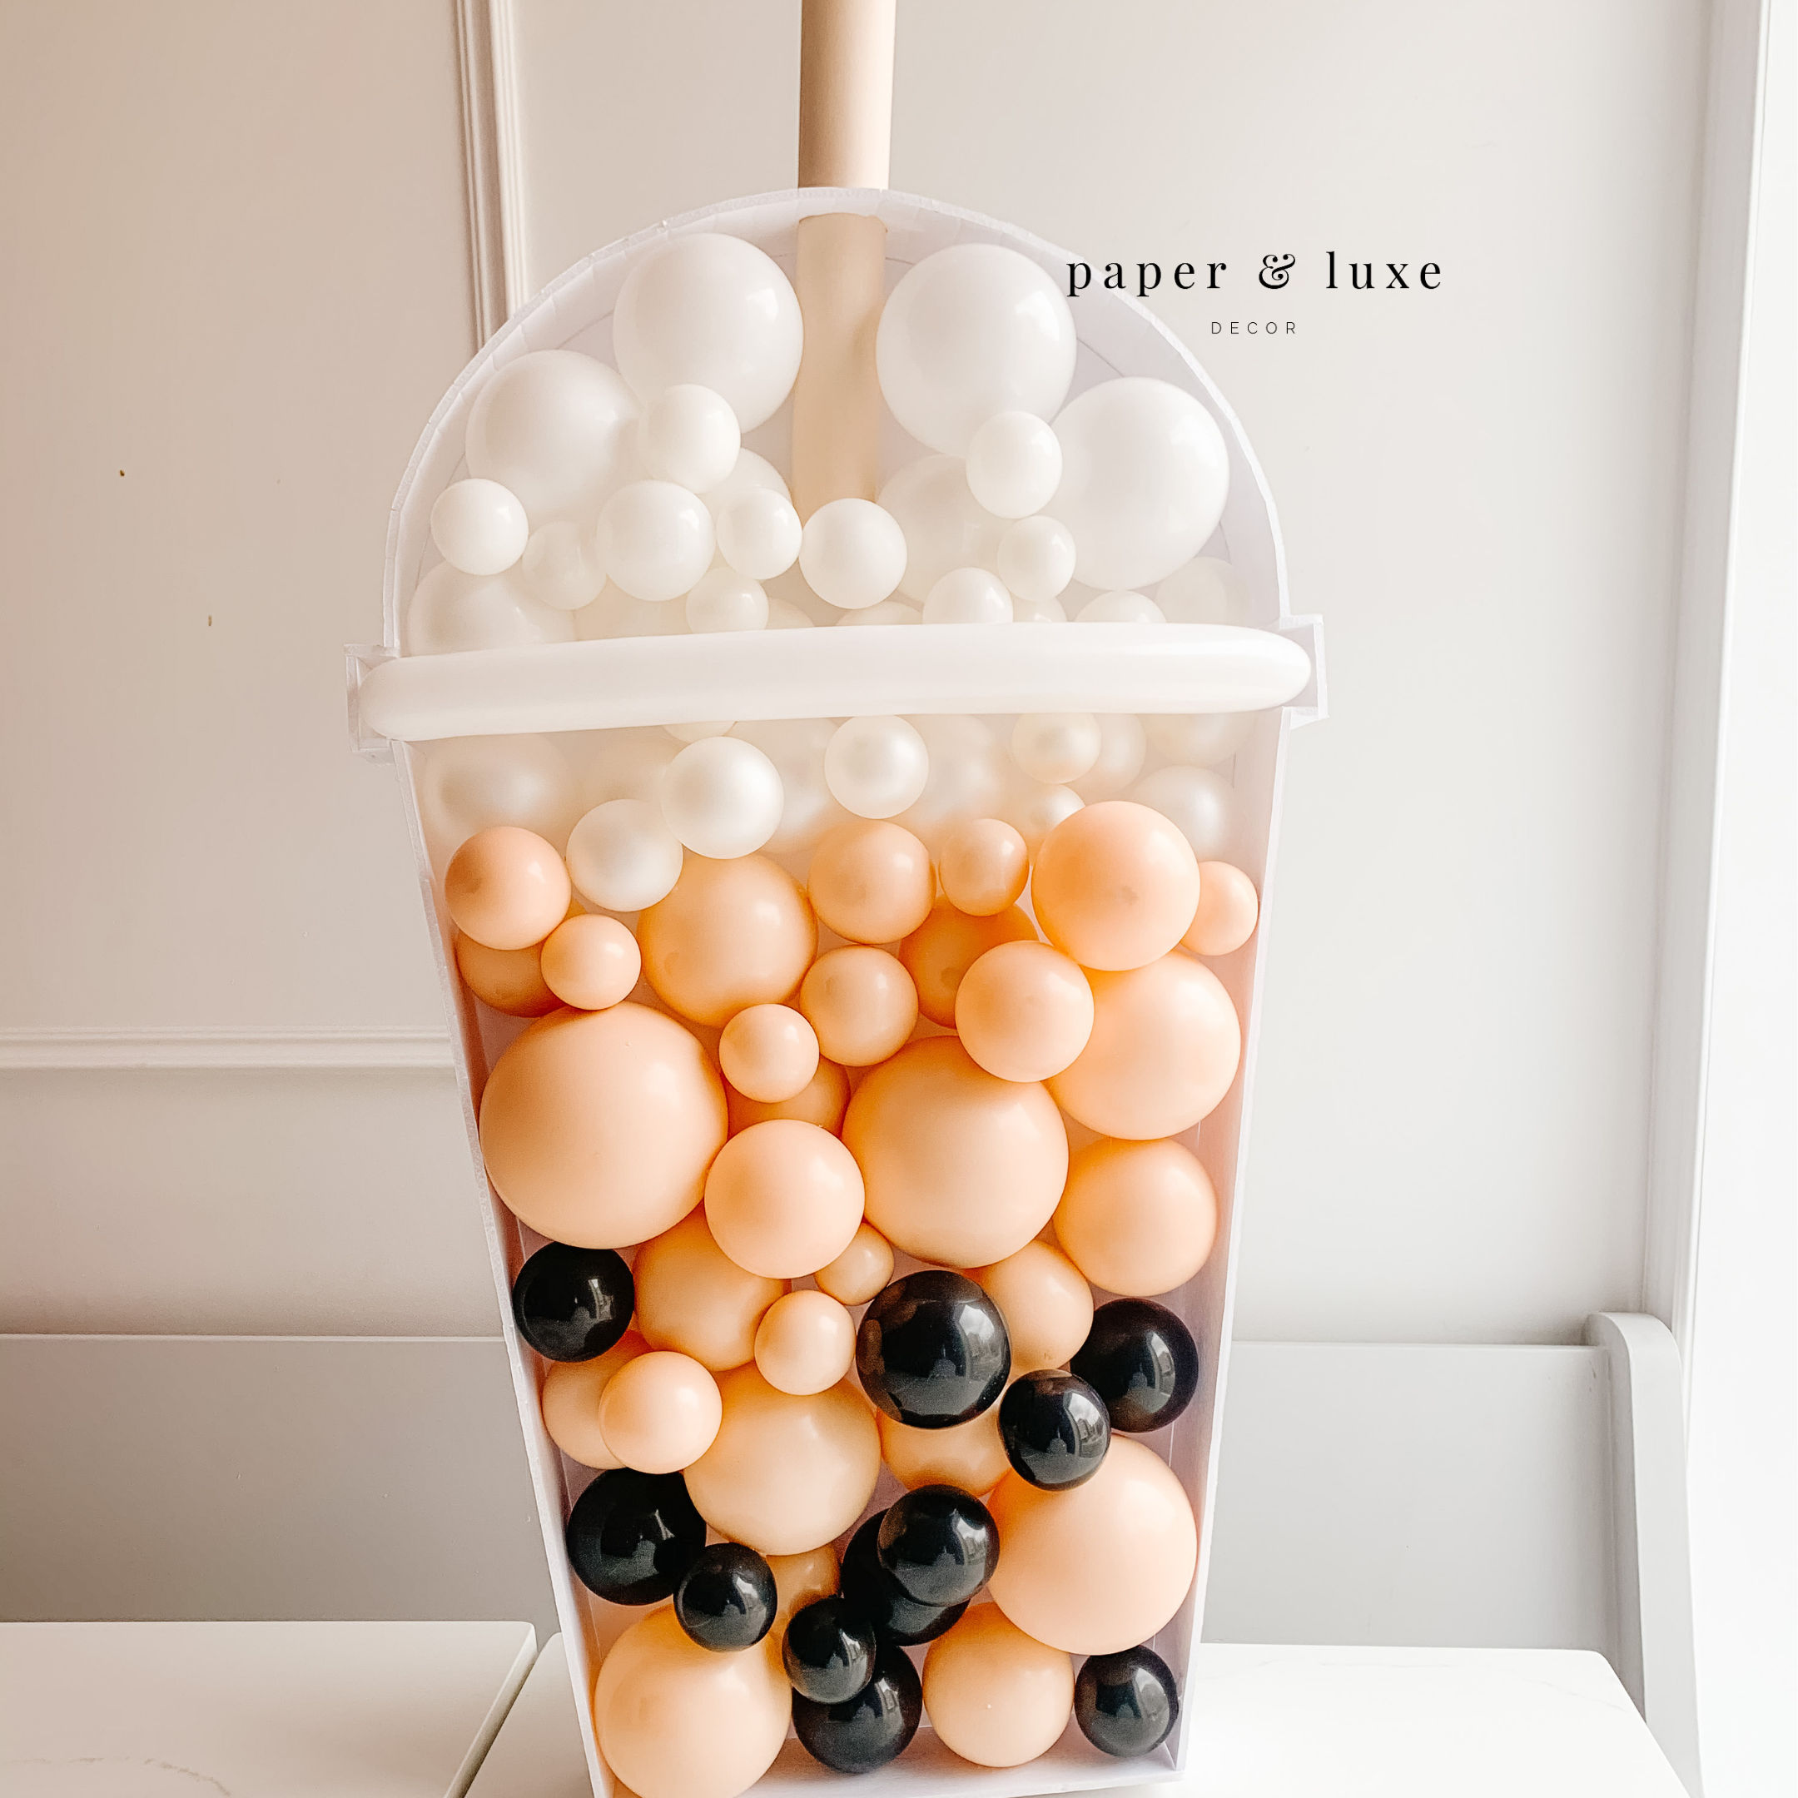
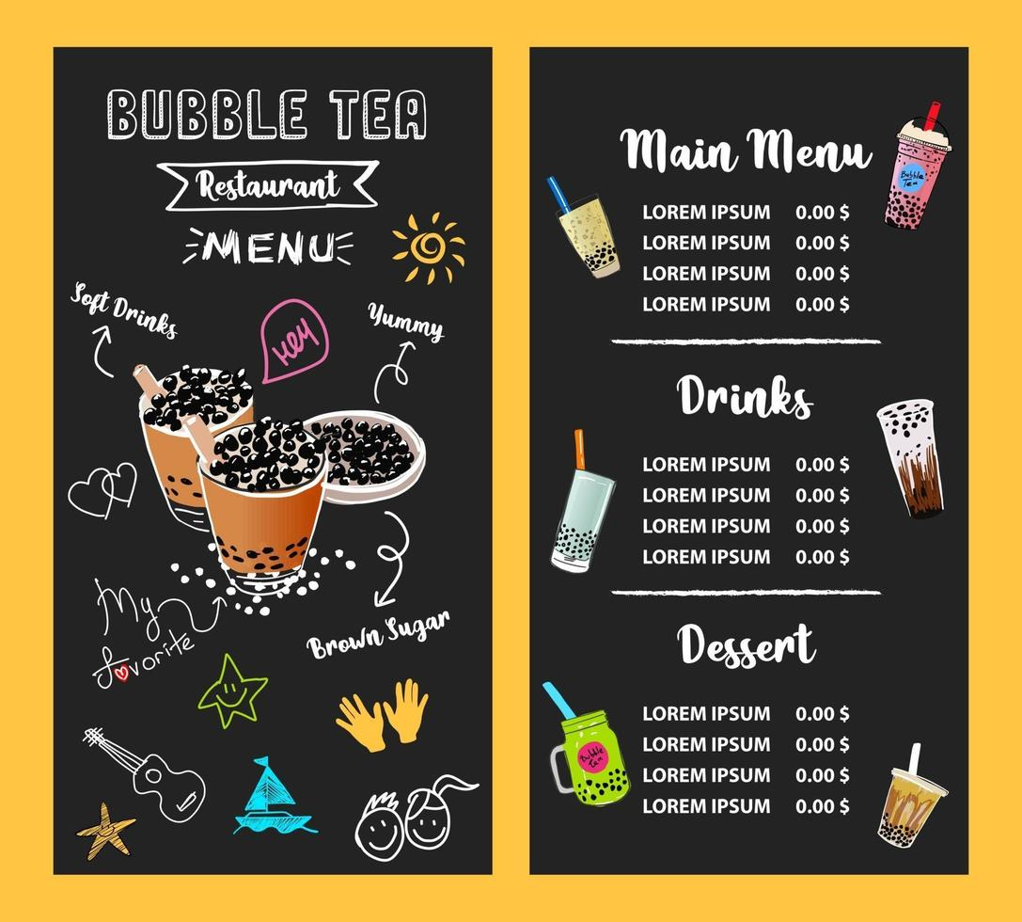
Bubble Popping – Site Layout
Main Page
Registration Site
Log in
Game Site
Customize your tea

Slide 2
START
CUSTOMIZE YOUR TEA

Slide 3
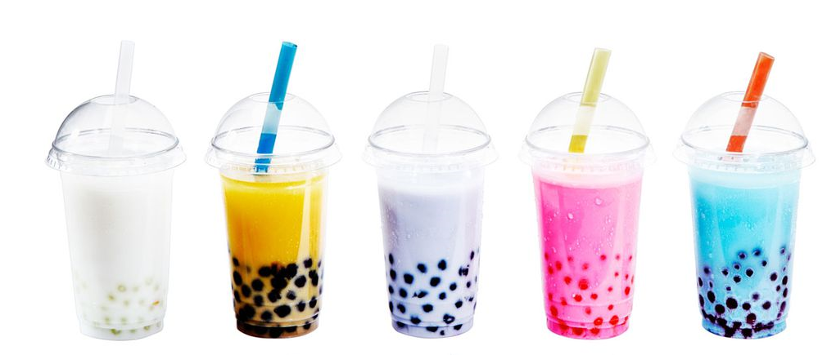
Bubble Popping - Target User
Teen Age 14 – 18 years old
According to a recent CLSA survey of consumers, 94% of those aged between 20 and 29 bought boba tea in the last three months, reported Bloomberg (June 24).
The Asia-Pacific region remains the largest shareholder of the bubble tea market. North America has seen an uptick in boba cafes, particularly in the Pacific Northwest, and is projected to be the second-largest leader in the bubble tea business.
https://foodinstitute.com/focus/survey-millennials-gen-z-big-fans-of-bubble-tea/

Slide 4
Bubble Popping
Register
Registration Form:
Name
E-mail -> e-mail confirmation/validation
Phone -> phone confirmation/validation
Password
Confirm Password
Create (button)
LOG IN
REGISTER
Timer
Form Validation
API Access
Data Base
- Needs Data Base

Slide 5
Bubble Popping
Log in
Log-in Form:
User
Password
Forgot Password -> e-mail/phone link
Remember Password
Log-in (button)
LOG IN
REGISTER

Slide 6
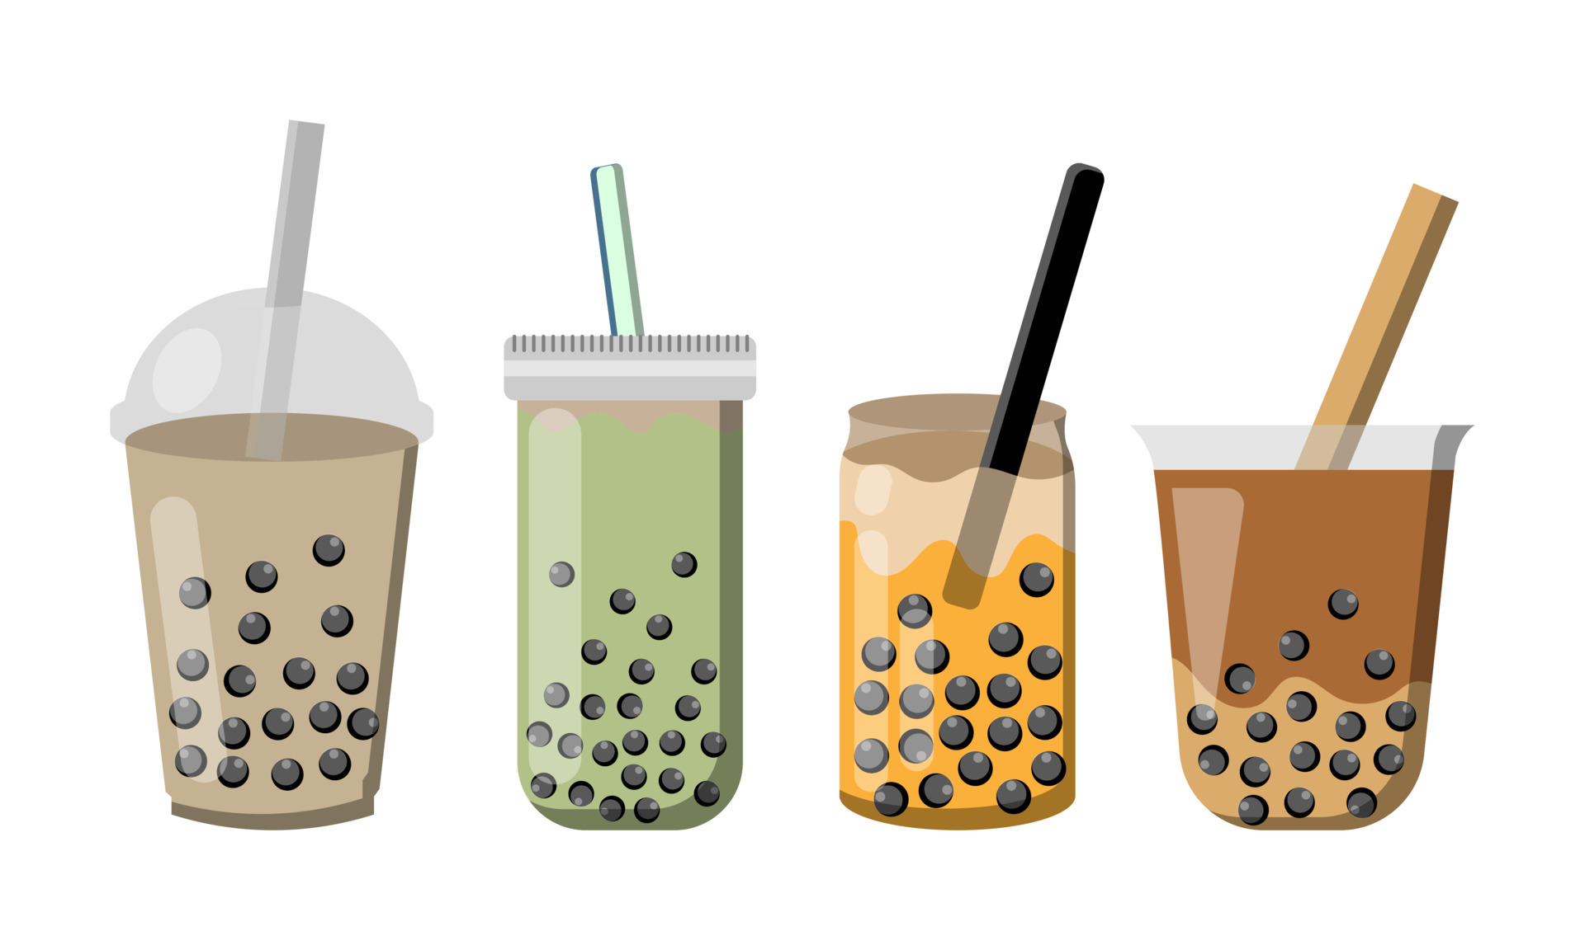
Bubble Popping
Game
Global Leader Board (You vs. All)
Highest Score
GAME RULES:
The user has X seconds during a round to gather a score
Each successful click on a Green bubble generates points and a streak
Streak exponentially increases score per bubble
Red bubbles Reset streak to 0
Gold bubbles move erratically and are worth Y Green bubbles worth of points
Colors are internal references only and do not reflect the final rendering
SCORE
RESTART
LOG IN
REGISTER
Level 1
Level 2
Level 3
CUSTOMIZE YOUR TEA
BACK HOME
EXIT
Notes:
More functional
All the parameters are dynamic and change the framerwork
Adding Dashboard

Slide 7
Bubble Popping
Customize your Tea
Clean up style
Tea Flavour
Bubble Types
BACK TO GAME
RESTART
LOG IN
REGISTER
Green Tea (Green)
Chai (Light Brown)
Coconut (white)
Taro
WaterMelon
Tapioca
Pudding
Grass jelly
Coconut
Rainbow
Mango Chunk
BACK HOME
EXIT

